Slide 1
Kinergy Applications

Slide 2
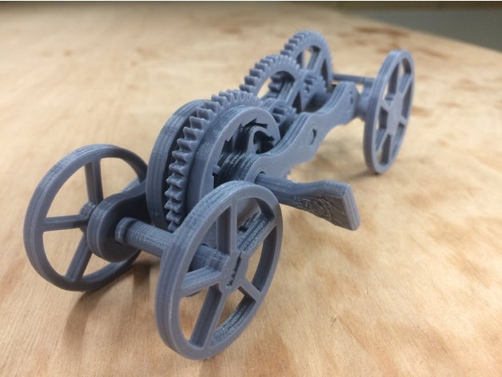
#1 Pull-back Car with Lock
Print out 3 cars with different motion parameters
for comparison.
Kinetic unit demonstration:
linear moving by twisting design

Slide 3
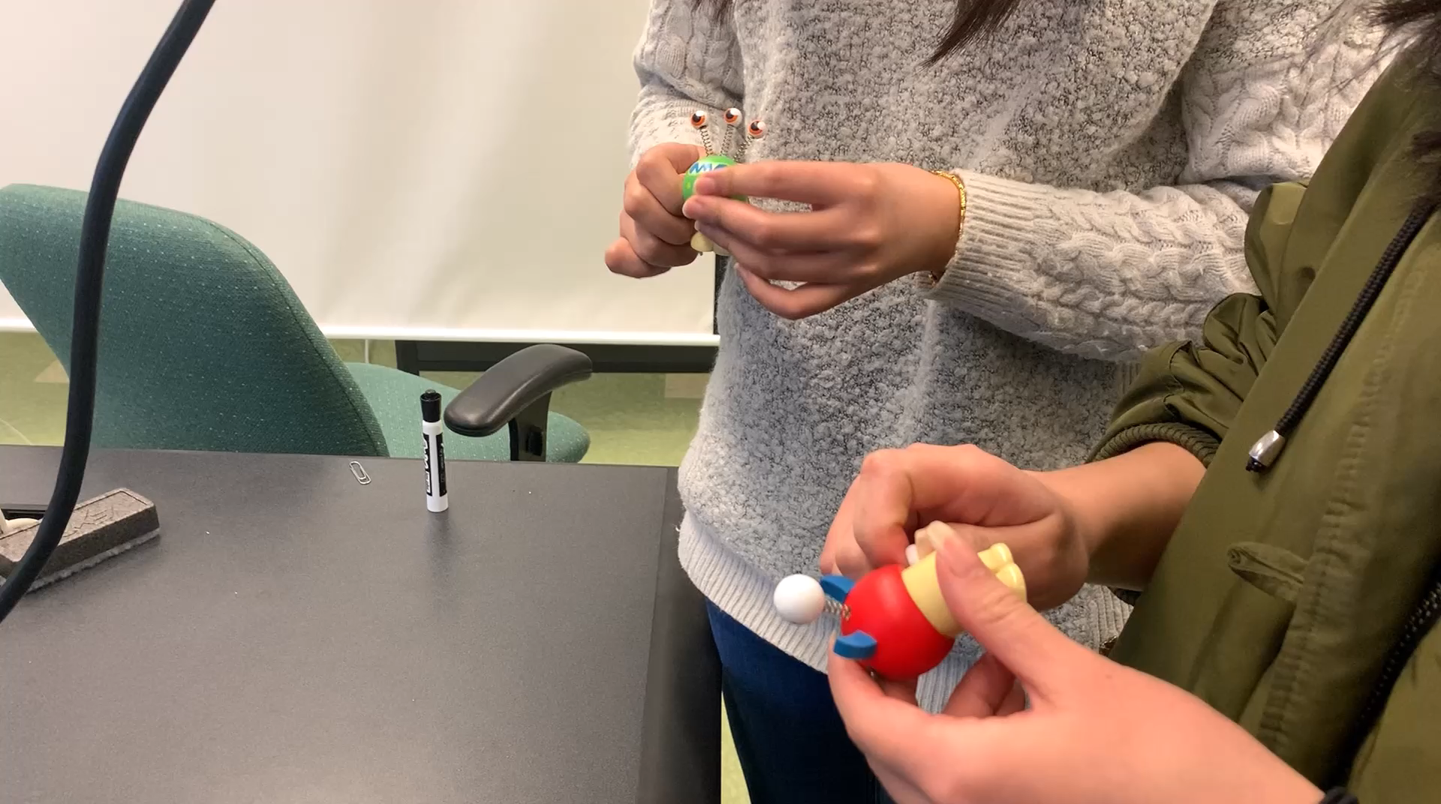
#2 Self-waking toy/robot
Could be modified for pressing to trigger the motion.
Kinetic unit demonstration:
linear moving by pressing design

Slide 4
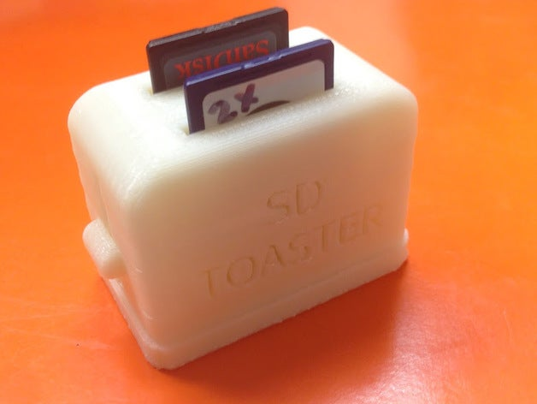
#3 Toaster
Might be a good retrofit for the trigger on an existing
bread toaster.
Kinetic unit demonstration:
Bouncing design

Slide 5
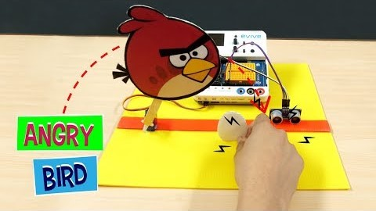
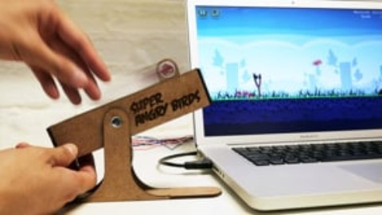
#4 Catapult/Interactive Gadget for Game
Customize a catapult-like gadget as a game input
gadget that allows the player to interact with the
game through physical devices.
Kinetic unit demonstration:
Throwing design

Slide 6
#5 A more complex rocket launcher?
Kinetic unit demonstration:
Bouncing design

Slide 7
#6 Prosthetics
Kinetic unit demonstration:
?? Maybe reciprocal linear motion?

Slide 8
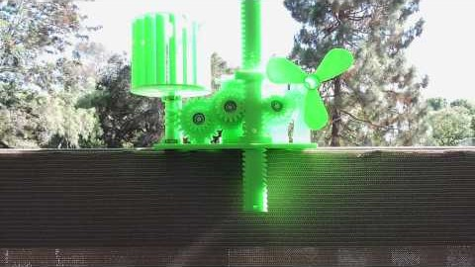
#7 Fan
This could be simplified into an all-in-one device.
Kinetic unit demonstration:
Rotatory motion by pressing design

Slide 9
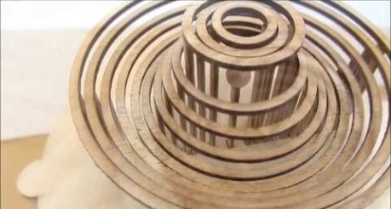
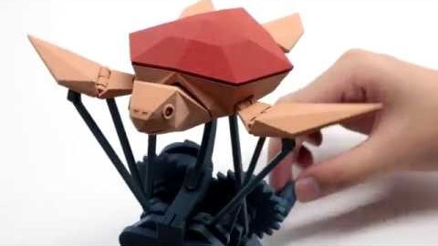
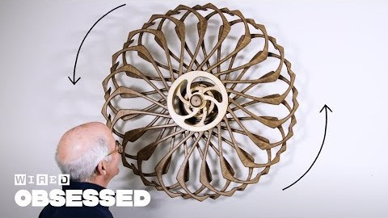
#8 Kinetic sculpture
Kinetic unit demonstration:
Spinning design / oscillation by gravity design /
Reciprocal linear motion design /
Reciprocal curved motion design

Slide 10
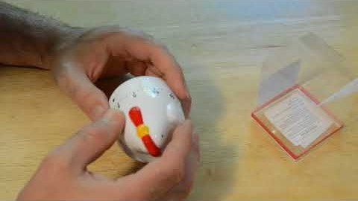
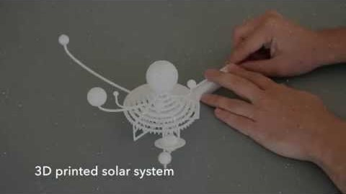
#9 Kitchen Timer
Maybe simplify the solar system to an earth-moon system.
Kinetic unit demonstration:
Rotatory motion by twisting design

